Slide 1
NOTE: Minimum viable product inside the blue boxes, optional features/tools inside broken boxes
Postgres Order Management Transactional DB/System
Seller registrations
Listing creations
Buyer registrations
Order transactions
Power BI
Visualization
To answer (sample questions for now):
What are staff’s productivity for L7D?
What part of the WH fulfilment process have highest lead time?
How many orders are processed/yet to be processed?
What are the items with the lowest stock?
What are the items with the highest average daily order?
Data warehousing
PySpark
Python Faker package for dummy data
Postgres Data Warehouse Storage
Postgres Warehouse Management Transactional DB/System
WH Personnel registrations
WH Personnel attendance
Storage and inventory
Order fulfilment processing
dbt (option 2)
Airflow (optional, if can learn or if have more time)

Slide 2












Postgres
dbt
Airflow
Google Cloud BigQuery
Power BI
GSheet
Listing & Promotion
Management System (LPMS)
User Management System (UMS)
Data Visualization
Marketplace
Data Mart
Order Management System (OMS)
ETL
Data Warehouse
Ad Hoc Querying
Warehouse Management System (WMS)
Warehouse
Data Mart
Reporting
Warehouse Information
Flat File

Slide 3
Postgres
dbt
Airflow
Google Cloud BigQuery
Power BI
GSheet
Data Visualization
Marketplace
Data Mart
Data Warehouse
Ad Hoc Querying
Warehouse
Data Mart
Reporting

Slide 4
Data Model
dim_ location
dim_ payment
dim_ warehouse
dim_ shipping
dim_ operator
dim_ voucher
dim_buyer
dim_item
dim_voucher_mix
dim_ task
dim_date
dim_seller
dim_order_parcel
dim_time
dim_staff
dim_order
dim_parcel_status
dim_ supplier
fact_order_detail
fact_parcel_detail
fact_order_item_detail
fact_parcel_status_snapshot
dim_ storage
fact_platform_performance_summary
fact_sku_performance_summary
fact_seller_performance_summary
fact_outbound_task _detail
fact_outbound_sku _detail
fact_outbound_order _detail
fact_storage_inventory _snapshot
fact_inbound_task _detail
fact_inbound_sku _detail
fact_attendance_snapshot
fact_warehouse _summary
fact_staff_prod _summary

Slide 5
dim_time
dim_parcel_status
fact_parcel_status_snapshot
dim_ location
dim_ operator
dim_order_parcel
fact_platform_performance_summary
fact_sku_performance_summary
fact_seller_performance_summary
dim_date
dim_date
dim_date

Slide 6
Data Model
dim_time
dim_date
dim_ warehouse
dim_order
fact_order_detail
dim_voucher_mix
dim_ payment
dim_seller
dim_buyer
dim_time
dim_ warehouse
dim_date
dim_time
dim_order
fact_order_item_detail
dim_seller
dim_date
dim_ warehouse
dim_item
dim_buyer
dim_order_parcel
fact_parcel_detail
dim_parcel_status
dim_ shipping
dim_seller
dim_buyer

Slide 7
dim_item
dim_ warehouse
dim_order_parcel
fact_outbound_sku _detail
dim_ shipping
dim_time
dim_date
dim_ task
dim_ warehouse
dim_order_parcel
fact_outbound_task _detail
dim_item
dim_time
dim_staff

Slide 8
dim_purchase_order_asn
dim_item
dim_ warehouse
dim_parcel_status
dim_ task
fact_inbound_task _detail
dim_ warehouse
dim_order_parcel
fact_outbound_order _detail
dim_ shipping
dim_staff
dim_time
dim_time
dim_date
dim_purchase_order_asn
dim_item
dim_ warehouse
fact_inbound_sku _detail
dim_ supplier
dim_time
dim_ storage

Slide 9
dim_ storage
dim_staff
dim_item
fact_storage_inventory _snapshot
dim_ warehouse
dim_date
fact_attendance_snapshot
dim_ warehouse
dim_date
dim_time
dim_time
dim_date
dim_date
fact_warehouse _summary
fact_staff_prod _summary
dim_ warehouse
dim_staff

Slide 10
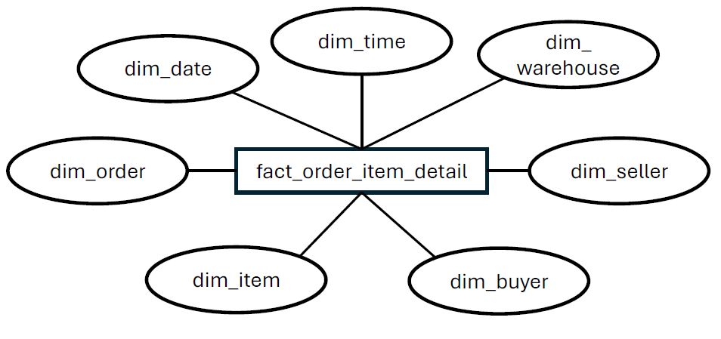
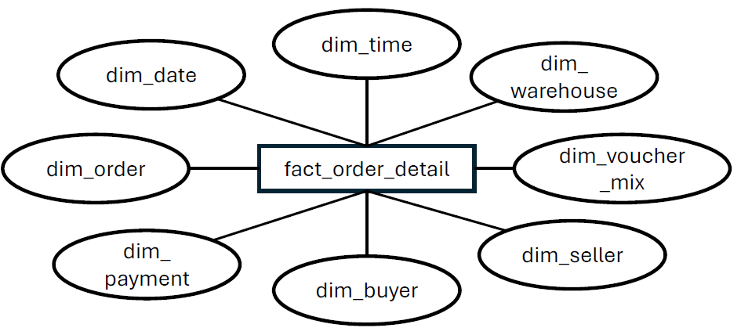
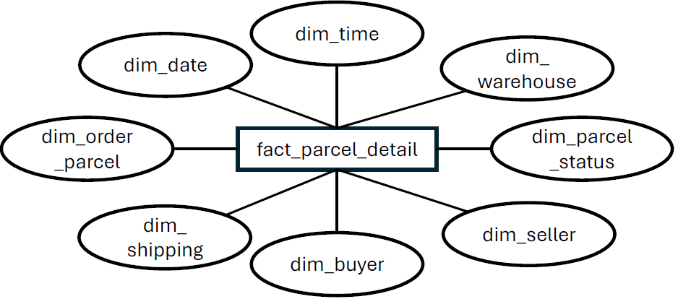
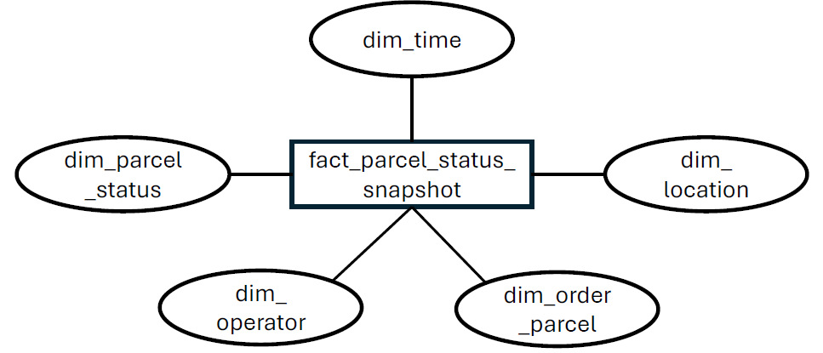
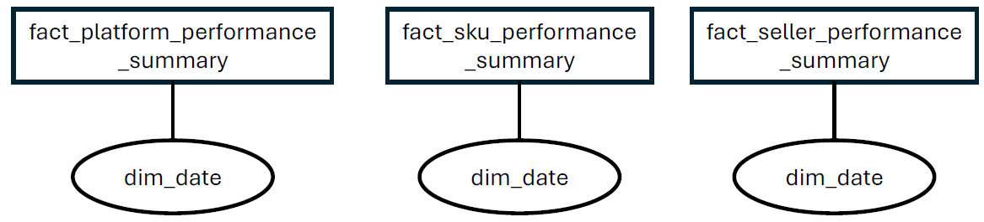

Slide 11
